Slide 1
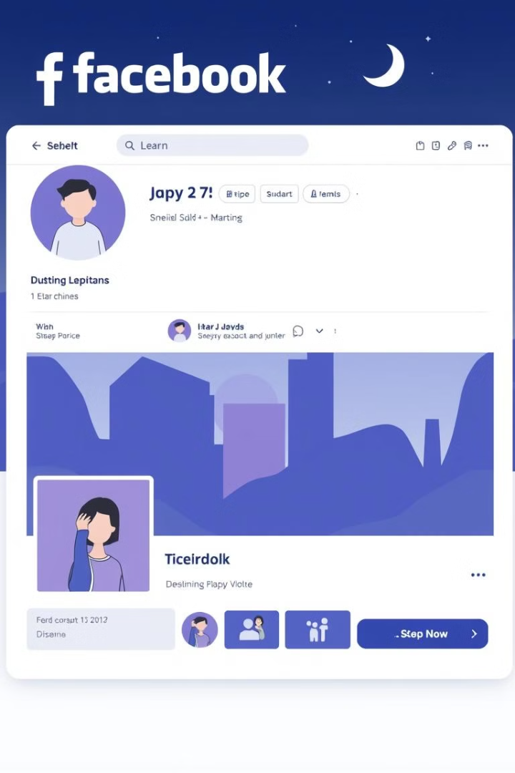
Facebook Clone
A simple Facebook UI clone designed using HTML, CSS, and JavaScript.
RH
by Rayan Hussain

Slide 2
Introduction
Project Overview
Purpose
A simple Facebook UI clone designed using HTML, CSS, and JavaScript.
To replicate the look and feel of Facebook’s core UI to enhance web development skills.
Features
Login and homepage design.
Interactive navigation bar.
Basic user interface elements like posts, likes, and comments layout.
Working Like Button and Refresh Page.
Login With Form validation & Authentification.

Slide 3
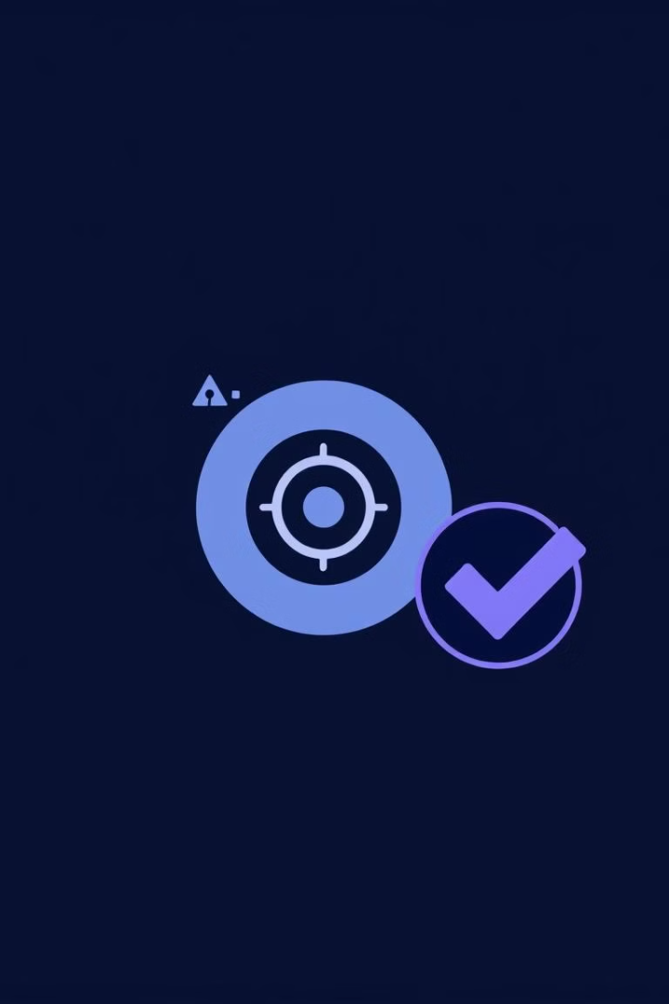
Website Objective and Target
Objective
Target Audience
Build a visually appealing UI similar to Facebook.
Beginners looking to understand social media UI designs.
Practice and showcase front-end development skills.
Developers exploring front-end technologies.

Slide 4
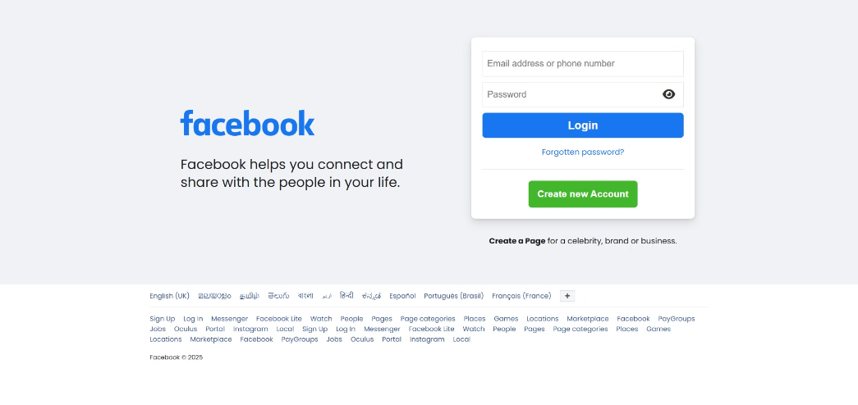
Login Page
Purpose
Features
Create a simple and intuitive login interface, Just Like Facebook With Exact designs.
Email and password input fields.
A "Login" button styled to mimic Facebook’s design.
Error messages for incorrect input (Form Validation).

Slide 5
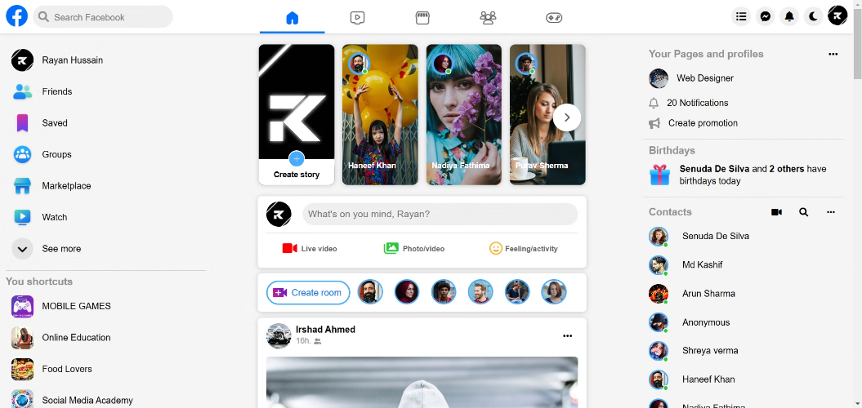
Home Page
Key Elements
Design Inspiration
Navigation bar with Hovering and Animation
Structured to resemble Facebook's classic homepage for familiarity.
A main feed section for posts.
Sidebar for friend suggestions and groups.
With Some Animations Similar to Facebook

Slide 6
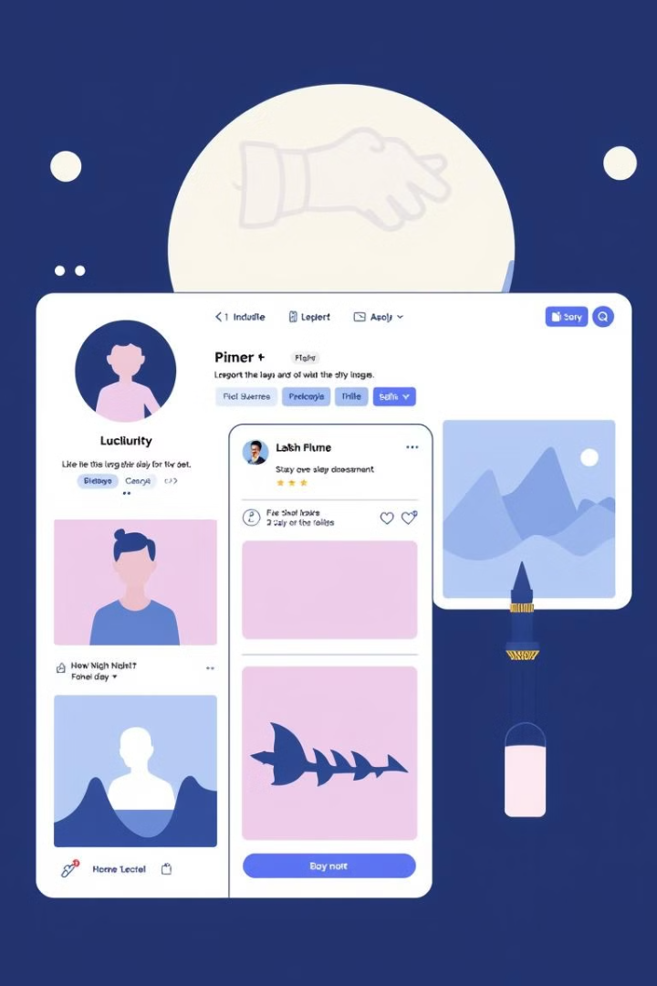
Navigation and User Experience
Navigation Bar
User Experience
Clean and straightforward, with clear labels.
Intuitive layout for easy navigation.
Responsive dropdown menus (if applicable).
Smooth scrolling and hover effects for interactive feedback.

Slide 7
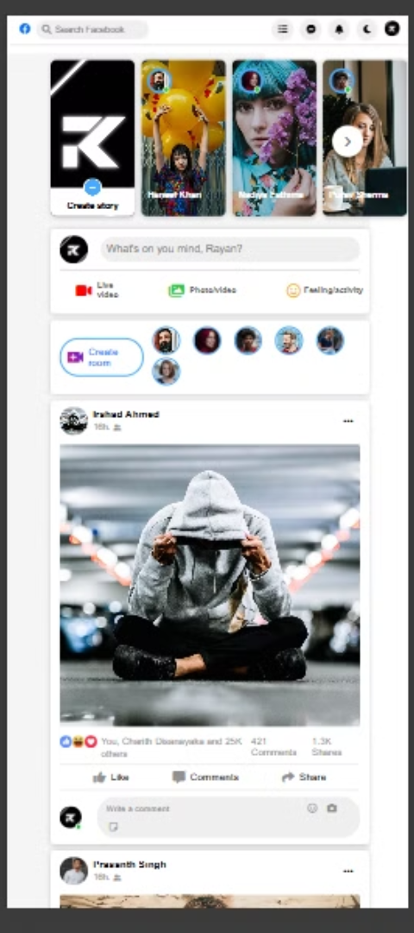


Responsive and Mobile Optimization
Responsiveness
Mobile Optimization
The design adapts seamlessly to various screen sizes.
Simplified navigation for smaller screens.
Touch-friendly buttons and clickable areas.
CSS media queries used for layout adjustments.

Slide 8



Future Enhancements
Functional Features
1
Implement real-time user authentication.
Add functionality for creating and commenting on posts.
UI/UX Improvements
2
Enhance animations and transitions.
Improve dark mode support.
Backend Integration
3
Incorporate a database for user data and posts.

Slide 9
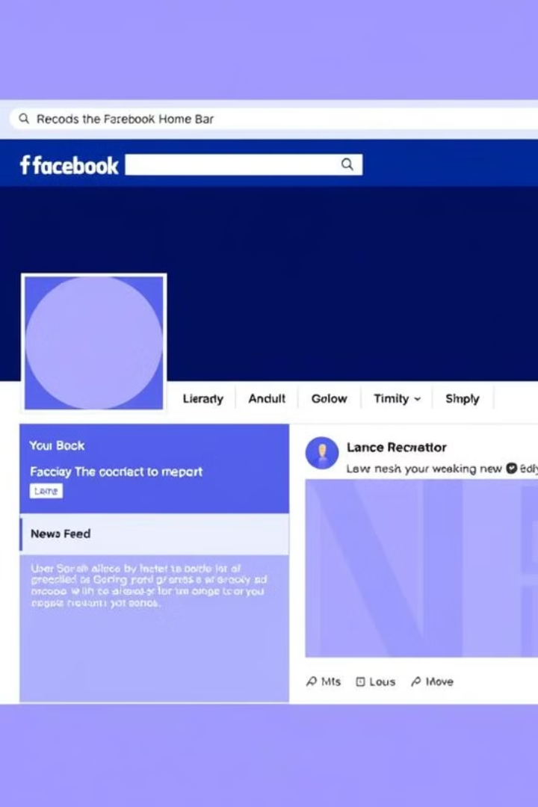
Conclusion
Key Takeaways
Next Steps
Successfully replicated Facebook’s basic UI using HTML, CSS, and JS.
Explore backend development to create a full-stack version.
Gained hands-on experience with front-end web development.

